Slide 1
R programming for beginners
Interacting with R
Jason Gullifer

Slide 2
Datasets for this section
Disney Vices
If you downloaded the workshop zip
Located: “docs/datasets/disney_vices.csv”
Or
"https://goo.gl/KGQ90a"

Slide 3
Using R
An overview

Slide 4
Outline
Opening R
R as a calculator
Scripts
Variables
Functions
Packages
Reading data into and out of R
read.csv
write.csv
Getting help
Notes:
Interaction with R:
*Up bring up last command, keep going up or down to get to the right line
*Run all of script, run part of script
*Getwd, setwd
*Tab-completion: completes command but also useful to get a list of commands
Packages to install:
*plyr, reshape, ggplot2, lme4, ez
Extra stuff?:
http://www.ling.upenn.edu/~joseff/rstudy/week1.html#why

Slide 5
Opening R
Double-click the R icon
You are now looking at the R console
Try some basic operations

Slide 6
R as a calculator
Function | Description | Example | Explanation
+ | Sum/add | 30 + 2 | 30 plus 2
- | Subtract | 30 - 2 | 30 minus 2
* | Multiply | 30*2 | 30 times 2
/ | Divide | 30/2 | 30 divided by 2
c() | Concatenate several things together | c(3,8,15,4) | 3, 8, 15, 4
mean() | Take the mean (average) of all values in a vector | mean(c(3,8,15,4)) | (3+8+15+4)/4 = 7.5
sd() | Take the standard deviation of all values in a vector | sd(c(3,8,15,4)
<- | Assign what is to the right of the arrow to whatever is left of the arrow | x <- 4 | x gets 4
= | Assign what is to the right of the = to whatever is left of the = | x = 4 | x gets 4

Slide 7
Scripts
Scripts
Text file where you store commands
Evaluated from top-bottom when run
Reproducible, can be run again and again
Can be repurposed
File → New File → R Script
Save it somewhere
Comments (#) vs commands

Slide 8
Working with scripts
Good idea to have scripts for each project you're working with.
Good idea to have a header section where you load data, and get it into the format you need. (fix errors in data, miscodings, etc.)
Then: I tend to play around a lot in the interpreter (the direct interface with R) and save commands that are important
Could have a scratch file too where you save everything
R history
Scripts are evaluated line by line, top to bottom.
Store commands in the order you execute them
From read.csv to present
If you mess up, just rerun the script from the beginning… nothing lost

Slide 9
First things first: changing directory
Before doing anything serious in R, you want to change your directory
setwd(“/Users/jason/Desktop”)
The directory is the file location in which you will be saving scripts/data
Also, if you are importing files to R, this is where R will be looking for them
Notes:
Can talk about good project management
Folders for each project
Multiple versions of scripts

Slide 10
Filesystem
Hierarchical organization of folder / directories
E.g.,
C:\Users\Jason\Desktop
/home/jason/Desktop
Slashes denote folders (Win: backslash-\; Mac/Linux: slash-/)

Slide 11
Filesystem
R and many other interpreted programming languages will operate in a "working directory"
E.g., /home/jason
If a file isn't in this directory, R won't find it, throw and error
You can either "change directory" to move the working directorysomewhere else, or specify a path to a file outside this directory
setwd("/home/jason/Desktop")
read.csv("file.csv")
-or-
read.csv("/home/jason/Desktop/file.csv")
#Read from file.csv in our Desktop

Slide 12
Absolute vs relative paths
Absolute paths - specific
"/home/jason/Desktop/"
Probably fail if you're sharing scripts, unless your name is jason
User should change
Relative paths
Assume we are working in the home directory (e.g., "/home/jason")
setwd("Desktop")
Can be easier to type if working within the interpreter
Good for sharing scripts… in this case, most users have a Desktop
If you are "packaging" files / data in subfolders, you know that folder will be there

Slide 13
What is a variable?

Slide 14
What is a variable?
A placeholder for a piece of information
Information comes in many shapes, sizes, and types…
Function | Description | Example | Explanation
<- | Assign what is to the right of the arrow to whatever is left of the arrow | x <- 4 | x gets 4
= | Assign what is to the right of the = to whatever is left of the = | x = 4 | x gets 4

Slide 15
Data Types
Jason’s conception | Data Type | Example
Numbers | Numeric | 12.3, 5, 999
 | Integer | 2, 3, 4, 99
 | Complex | 2 + 3i
Strings of characters / numbers | Character | “a”, “cat”
 | Factor | Male, Female
Logical | Logical | TRUE, FALSE, T, F
Complex objects | Lists | list(c(2,5,3),21.3,mean)
 | Vectors | One-dimensional
 | Matrices | Two-dimensional
 | Arrays | Multi-dimensional
 | Data frames | Multi-dimensional different types
Gender: Male, Female
Condition: A, B

Slide 16
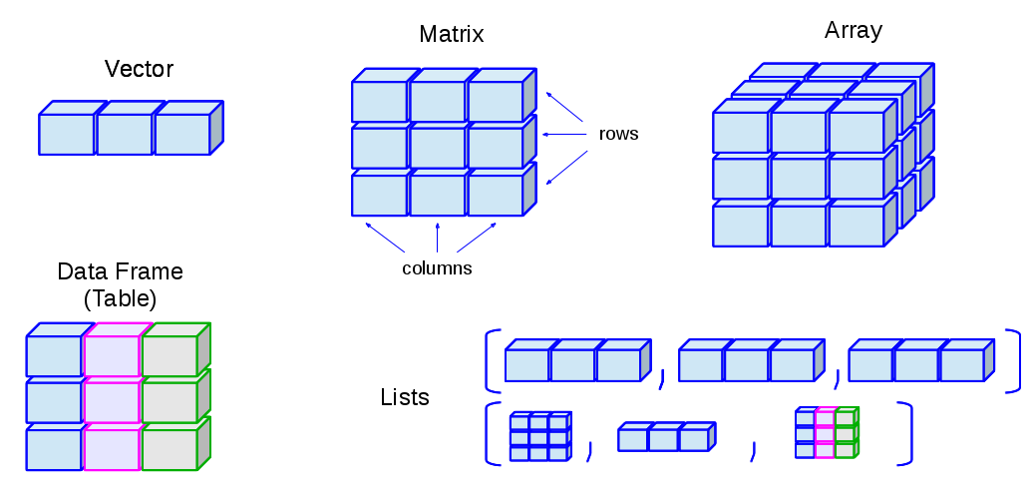
Data Types
http://venus.ifca.unican.es/Rintro/dataStruct.html

Slide 17
Where to get help
?function_here
?mean
Jason's preferred method
Google your problem with "r-project" somewhere
Examples:
r-project repeated measures anova
r-project change column names using ddply

Slide 18
Tips and tricks
Tab completion
Scrolling through history

Slide 19
What is a function?

Slide 20
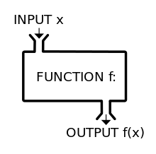
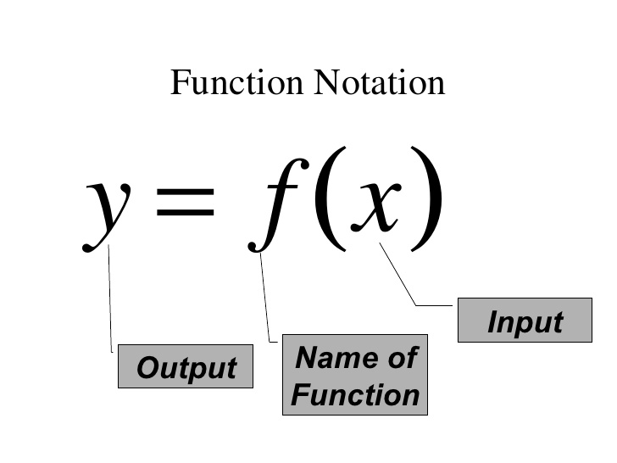
What is a function?
Something (i.e., an object)
Takes input
Does a bunch of stuff
Returns an output

Slide 21
You are a function!
Your data
You calculated your means for each subject in each condition
SDs for each subject in each condition
You even found that error where you calculated the mean from the wrong column
Your spreadsheet is awesome
Input
Function
Output
Why not have something do some of the work for you, swap out that old jason() function for a new and improved version

Slide 22
The package
R comes linked to a repository of packages
Install a package [choose a download mirror]
Load the package (each time you open R)
E.g., installing packages “plyr” and “reshape”
install.packages(“dplyr”)
install.packages(“reshape2”)
update.packages()
library(dplyr)
library(reshape2)

Slide 23
Packages
Using library() to load a package will attach several functions and datasets to R.
Sometimes this may overwrite functions and packages available in R.

Slide 24
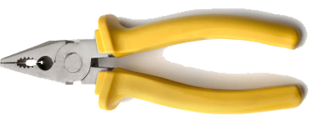
Useful Packages
Plyr
Information: http://plyr.had.co.nz/
Installing
install.packages(“plyr”)
Dplyr
Installing
install.packages(“dplyr”)
reshape
http://had.co.nz/reshape/
Installing
install.packages(“reshape”)
ggplot2
http://ggplot2.org
Installing
install.packages(“ggplot2”)
Hadley Wickham – R-diety

Slide 26
Reading data into and out of R
The CSV
Comma separated values
Lose formatting from excel (highlights; worksheets; etc.)
The disney vices dataset
vices <- read.csv(“disney_vices.csv”)
[do a bunch of stuff to your data]
write.csv(vices, “disney_vices_updated.csv”)

Slide 27
Benefits of plyr
trial subject RT
1 1 250
2 1 350
3 1 257
4 1 600
1 2 302
2 2 310
3 2 305
4 2 312
Big benefits!
You can summarise your data into a new data.frame
You can transform your original trial-level data to have the values
Allows you to do stuff with these values in the trial-level frame later!
summarise
transform
subject mean_RT sd_RT
1 364.25 163.64
2 307.25 4.57
trial subject RT mean_RT
1 1 250 364.25
2 1 350 364.25
3 1 257 364.25
4 1 600 364.25
1 2 302 307.25
2 2 310 307.25
3 2 305 307.25
4 2 312 307.25

Slide 28
Summarize the mean number of seconds alcohol is used for each of the companies
ddply(data, .(Company), summarise, mAlcohol=mean(Alcohol_Seconds))
Compute the mean number of seconds alcohol is used for each of the companies, and add it back to the original dataset
ddply(data, .(Company), transform, mAlcohol=mean(Alcohol_Seconds))

Slide 29
Benefits of reshape
Where ddply executes some operation for each subset of your data
Reshape converts between long and wide formats of data

